Slide 1


深度學習 Deep Learning
Course Introduction
Instructor: 林英嘉 (Ying-Jia Lin)
2025/02/17

Slide 2


Course Website & Slido
113-2
Deep Learning
https://github.com/mcps5601/CGUDL_2025_Spring
# 2875729
(Link)

Slide 3




About Me
Experience and Education (Time)
Assistant Professor | Department of Artificial Intelligence, Chang Gung University (2025/02 - )
Postdoctoral Researcher | Department of Computer Science, National Tsing Hua University (2024/09 - 2025/01)
Ph.D. | Department of Computer Science and Information Engineering, National Cheng Kung University (2019/08 - 2024/02)
M.S. | Institute of Biomedical Informatics, National Yang-Ming University (2017/09 - 2019/07)
B.S. | Department of Biomedical Sciences, Chang Gung University (2013/09 - 2017/06)
🪖

Slide 4
Outline
Introduction to Machine Learning and Deep Learning
History of Deep Learning
Course Introduction and requirements

Slide 5
Outline
AI / Deep Learning 到底是什麼？
深度學習為什麼現在變強了？
我們這學期要學什麼？

Slide 6
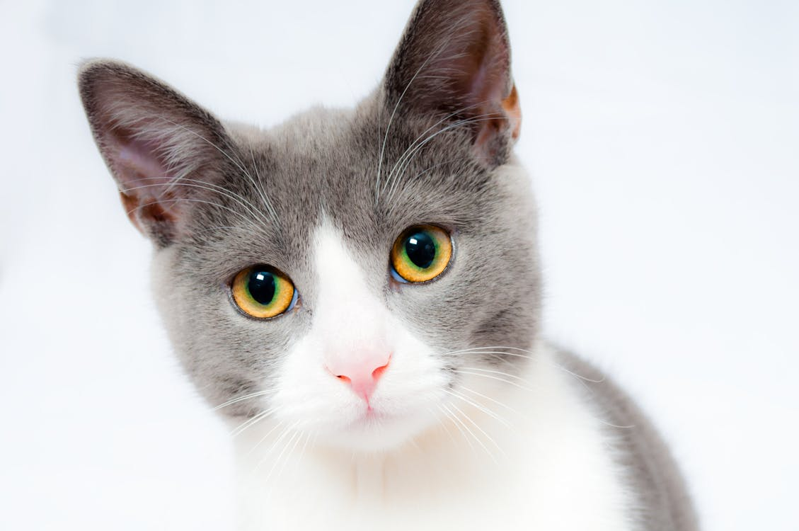

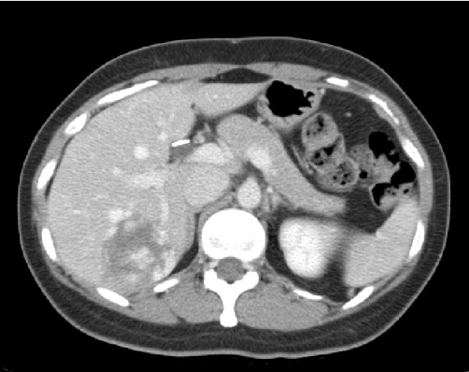
What is Deep Learning?
We start the concepts from machine learning.
Machine Learning function!
Cat
Classifier
Dog
Apple
Classifier
Malignant
Benign

Slide 7
How about DL in Natural Language Processing?
Sentiment Analysis (IMDb dataset ^{[1]})
This movie was awful. The ending was absolutely horrible.
Classifier
Positive
Negative
Translation, EN-ZH (WMT-19 dataset ^{[2]})
Machine Translation Model
Yet not nearly enough has been invested in this effort.
但目前這方面的投入還遠遠不夠。
[1] https://huggingface.co/datasets/stanfordnlp/imdb
[2] https://huggingface.co/datasets/wmt/wmt19/viewer/zh-en

Slide 8

Training a model to play Super Mario
Using reinforcement learning.
Code: https://github.com/jiseongHAN/Super-Mario-RL

Slide 9
[Definition] What is Deep Learning?
Deep learning is a machine learning approach that focuses on utilizing artificial neural networks with multiple layers (很多層的類神經網路) to perform tasks, such as classification, generation, and so on.
Usually, the number of parameters is big in a deep learning model, which results from the increased number of hidden layers and hidden size.

Slide 10
Venn Diagram about AI, ML, and DL
Machine Learning (ML)
Deep Learning (DL)
Ex. Logistic Regression
Ex. 專家系統 (Expert system; Knowledge base)
Ex. Multi-layer Perceptron
Artificial Intelligence (AI)

Slide 11
Perceptron (感知機)
Before we talk about multi-layer perceptron (MLP, 多層感知機)
Hidden size
Hidden size
輸入層
(1st 層)
輸出層
(2nd 層)
輸入層
(1st 層)
輸出層
(2nd 層)

Slide 12

A Biological Neuron vs. Perceptron
Hidden size
輸入層
(1st 層)
輸出層
(2nd 層)
Figure source: https://zh-yue.wikipedia.org/wiki/神經細胞

Slide 13
Math for Perceptron using a toy example (1)
Hidden size
輸入層
(1st 層)
輸出層
(2nd 層)

Slide 14
Math for Perceptron using a toy example (2)
Hidden size
輸入層
(1st 層)
輸出層
(2nd 層)

Slide 15
A toy example for classification
Group0
Group1
x1 | x2 | Output
0 | 0 | 0
0 | 1 | 1
1 | 0 | 1
We can just draw a line to classify two groups!

Slide 16
A toy example for classification with Perceptron
Group0
Group1
1
0.5
1
-0.5
-0.5
0.5
We can just draw a line to classify two groups!

Slide 17
XOR Problem
x1 | x2 | OR
0 | 0 | 0
0 | 1 | 0
1 | 0 | 0
1 | 1 | 1
x1 | x2 | OR
0 | 0 | 0
0 | 1 | 1
1 | 0 | 1
1 | 1 | 1
x1 | x2 | XOR
0 | 0 | 0
0 | 1 | 1
1 | 0 | 1
1 | 1 | 0

Slide 18
XOR Problem
Group0
XOR: Exclusive-or
Group1
x1 | x2 | XOR
0 | 0 | 0
0 | 1 | 1
1 | 0 | 1
1 | 1 | 0
We cannot just draw a line to classify two groups!

Slide 19
XOR Problem
Group0
XOR: Exclusive-or
Group1
x1 | x2 | XOR
0 | 0 | 0
0 | 1 | 1
1 | 0 | 1
1 | 1 | 0
We cannot just draw a line to classify two groups!

Slide 20
XOR Problem
Group0
XOR: Exclusive-or
Group1
x1 | x2 | XOR
0 | 0 | 0
0 | 1 | 1
1 | 0 | 1
1 | 1 | 0
We cannot just draw a line to classify two groups!

Slide 21
MLP for the XOR Problem
ReLU (Rectified Linear Unit)
輸入層
(1st 層)
隱藏層
(2nd 層)
輸出層
(3rd 層)
Perceptron通常沒有隱藏層

Slide 22
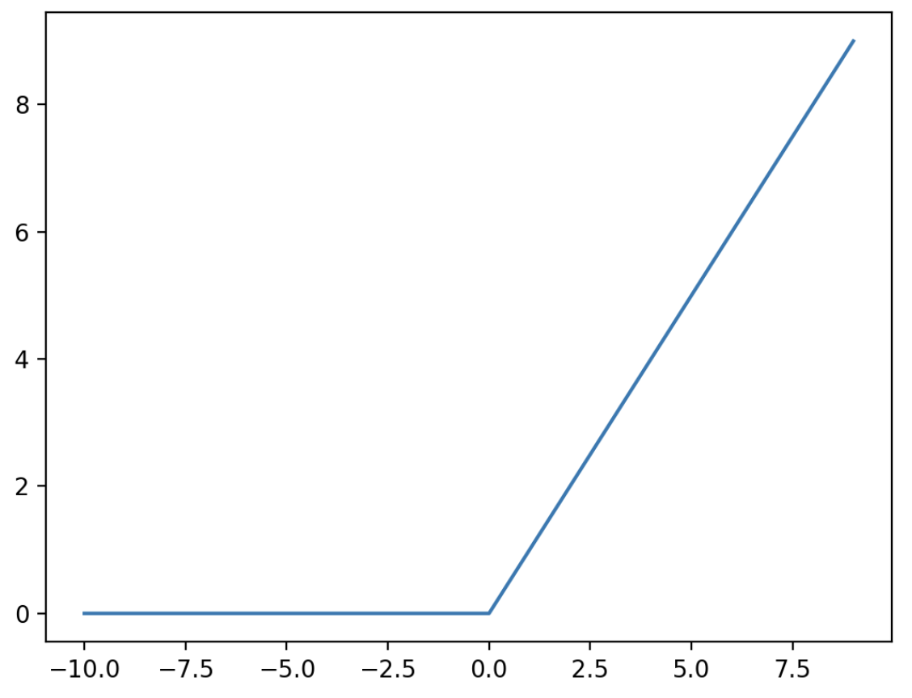
ReLU (Rectified Linear Unit)^{[1][2]}
Non-linear transformation
Negative values will be transformed to zeros.
Positive values remain their original ones.
Figure source: https://paperswithcode.com/method/relu
[1] Jarrett, Kevin, et al. "What is the best multi-stage architecture for object recognition?." ICCV 2009.
[2] Nair, Vinod, and Geoffrey E. Hinton. "Rectified linear units improve restricted boltzmann machines." ICML 2010.

Slide 23
Math of MLP for the XOR Problem (1)
任一筆資料
1
1
0
-1
1
1
x1 | x2
0 | 0
0 | 1
1 | 0
1 | 1
Element-wise summation with bias

Slide 24
Math of MLP for the XOR Problem (2)
ReLU
ReLU (Rectified Linear Unit)
Figure source: https://paperswithcode.com/method/relu

Slide 25
Math of MLP for the XOR Problem (2)
Current values

Slide 26
Math of MLP for the XOR Problem (3)
任一筆資料
1
0
0
-2
可視為分類層

Slide 27
Visualization of MLP for the XOR Problem
Before the last layer
Final values
0
1
0

Slide 28
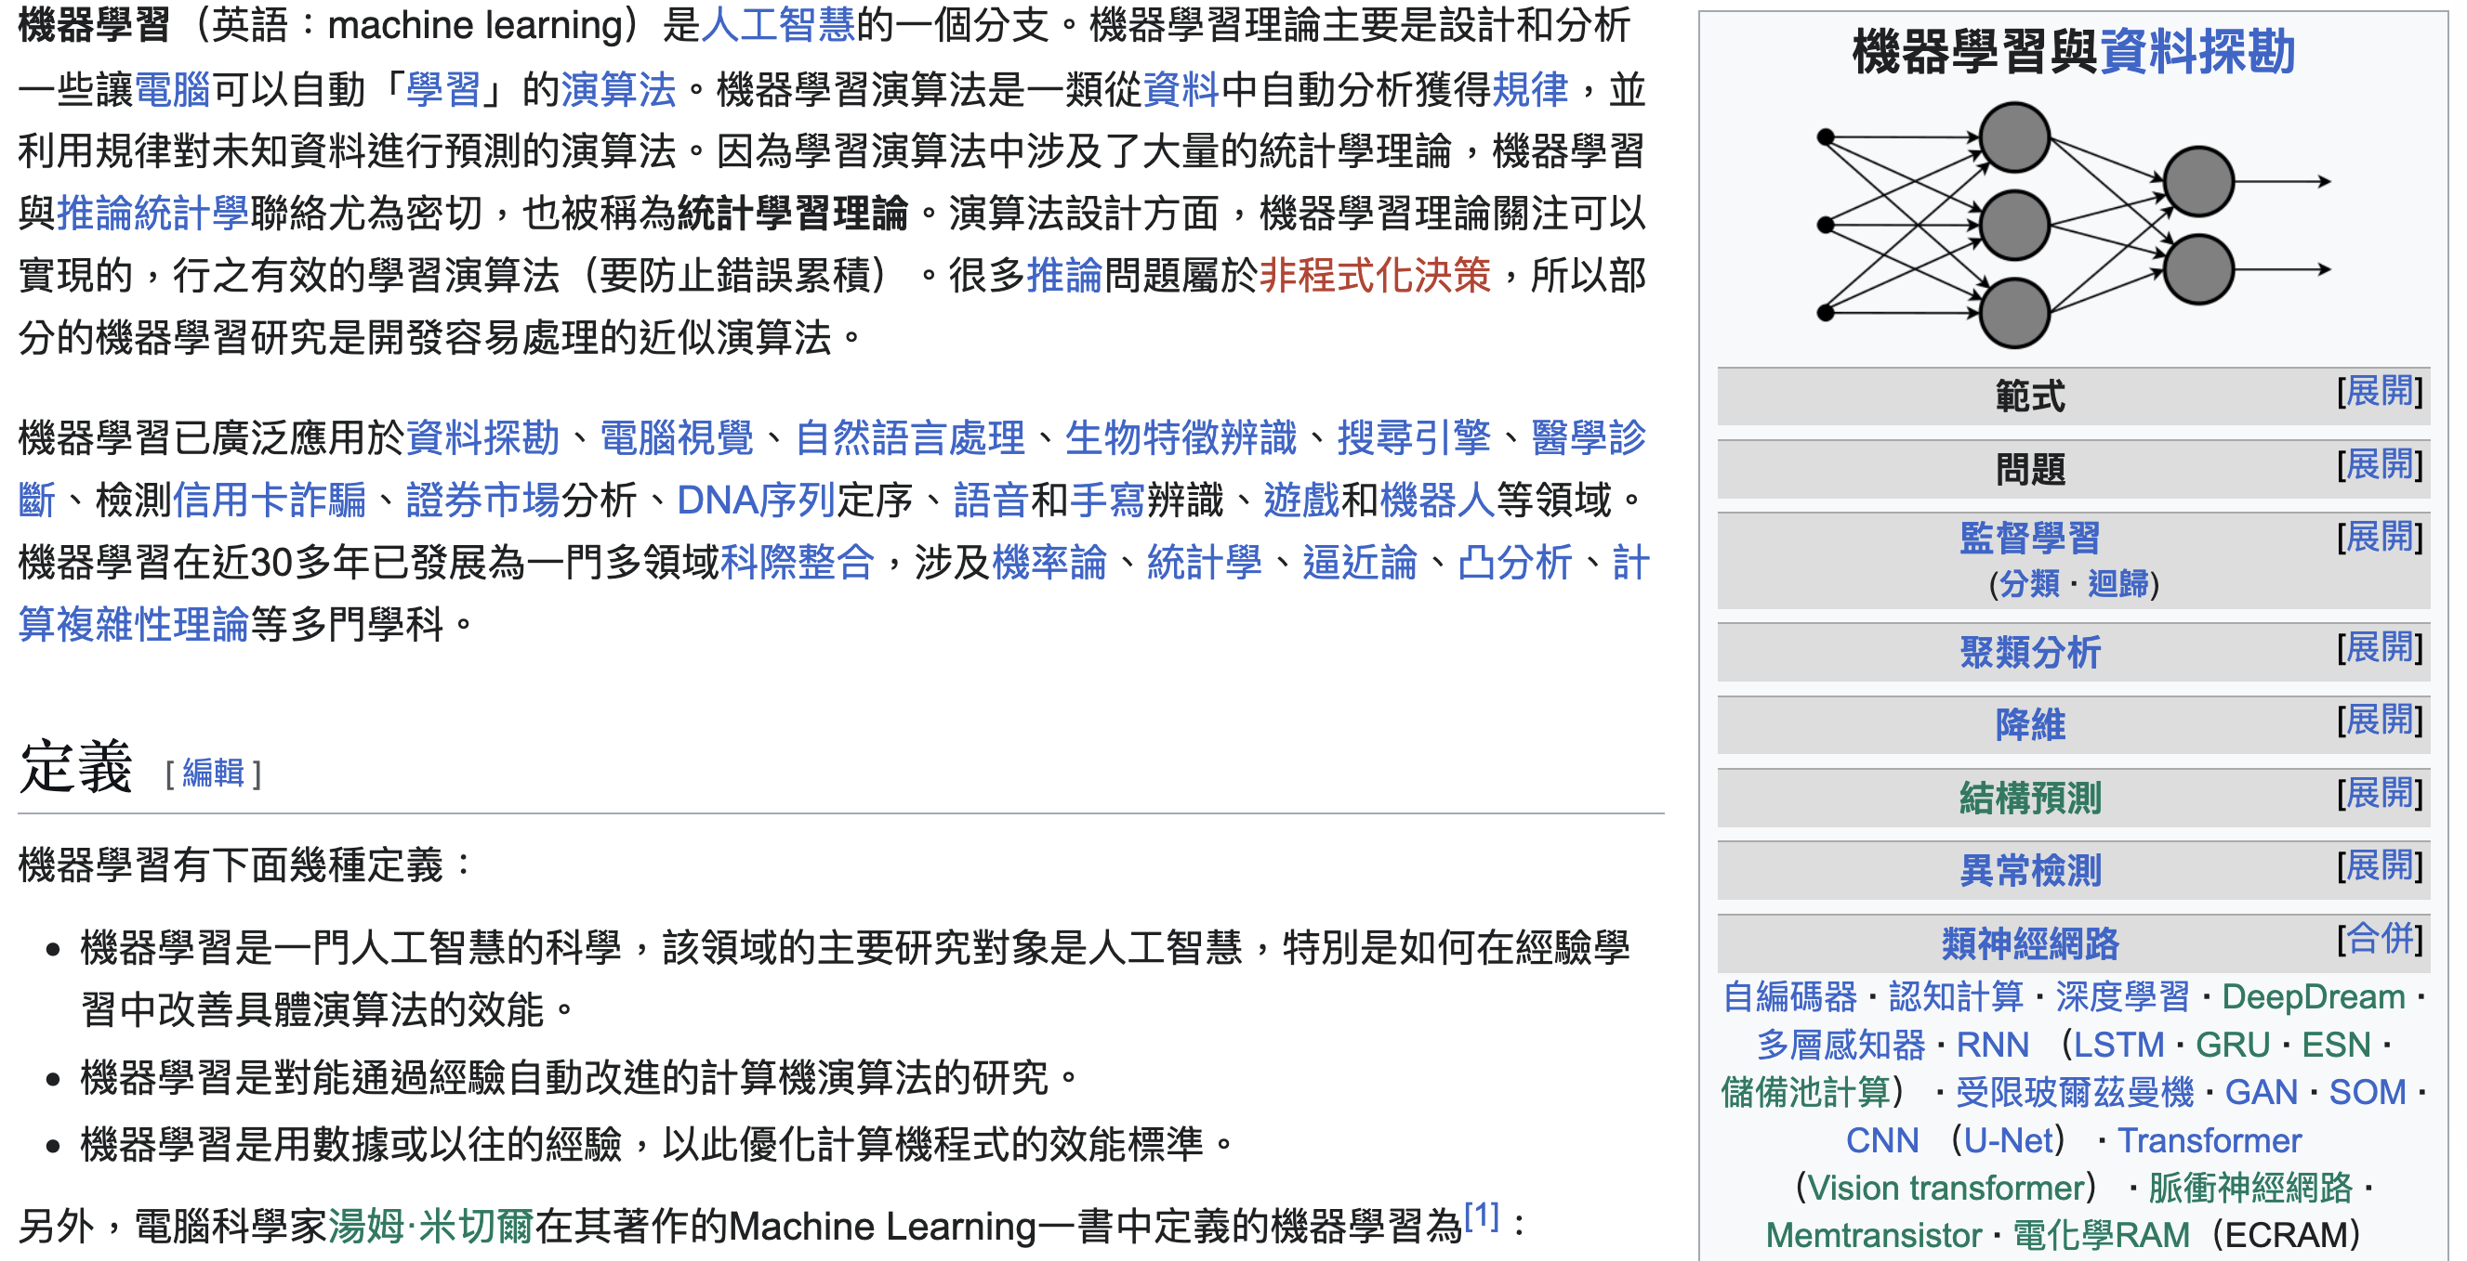
MLP is also one of the ML methods!
https://zh.wikipedia.org/zh-tw/%E6%A9%9F%E5%99%A8%E5%AD%B8%E7%BF%92

Slide 29
Deeper and Wider (加深、加寬)
Larger hidden size
More hidden layers

Slide 30
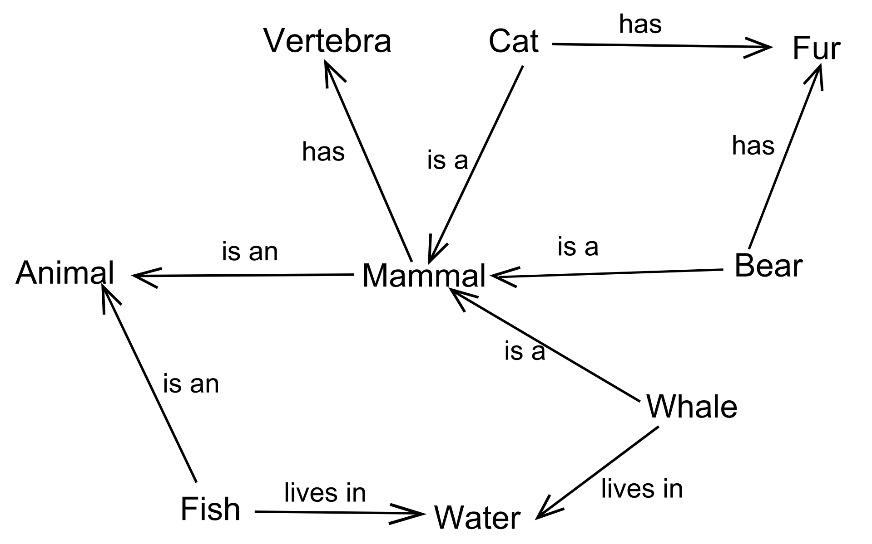
An example of Semantic Net (語義網路)
Figure source: https://zh.wikipedia.org/zh-tw/人工智慧史

Slide 31
深度學習為什麼現在變強了？

Slide 32

Difference between AI, ML, and DL
Figure source: https://blogs.nvidia.com/blog/whats-difference-artificial-intelligence-machine-learning-deep-learning-ai/

Slide 33
圖靈測試 (Turing Test)
Proposed by Alan Turing in 1950
One of the earliest concepts of artificial intelligence.
🤖
🧑‍💻
🗒️
🗒️
?
🙎‍♂️

Slide 34
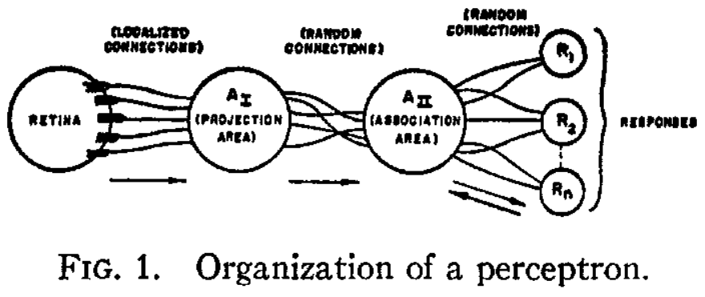
The first Perceptron (1958)
Rosenblatt, Frank. "The perceptron: a probabilistic model for information storage and organization in the brain." Psychological review 65.6 (1958): 386.

Slide 35
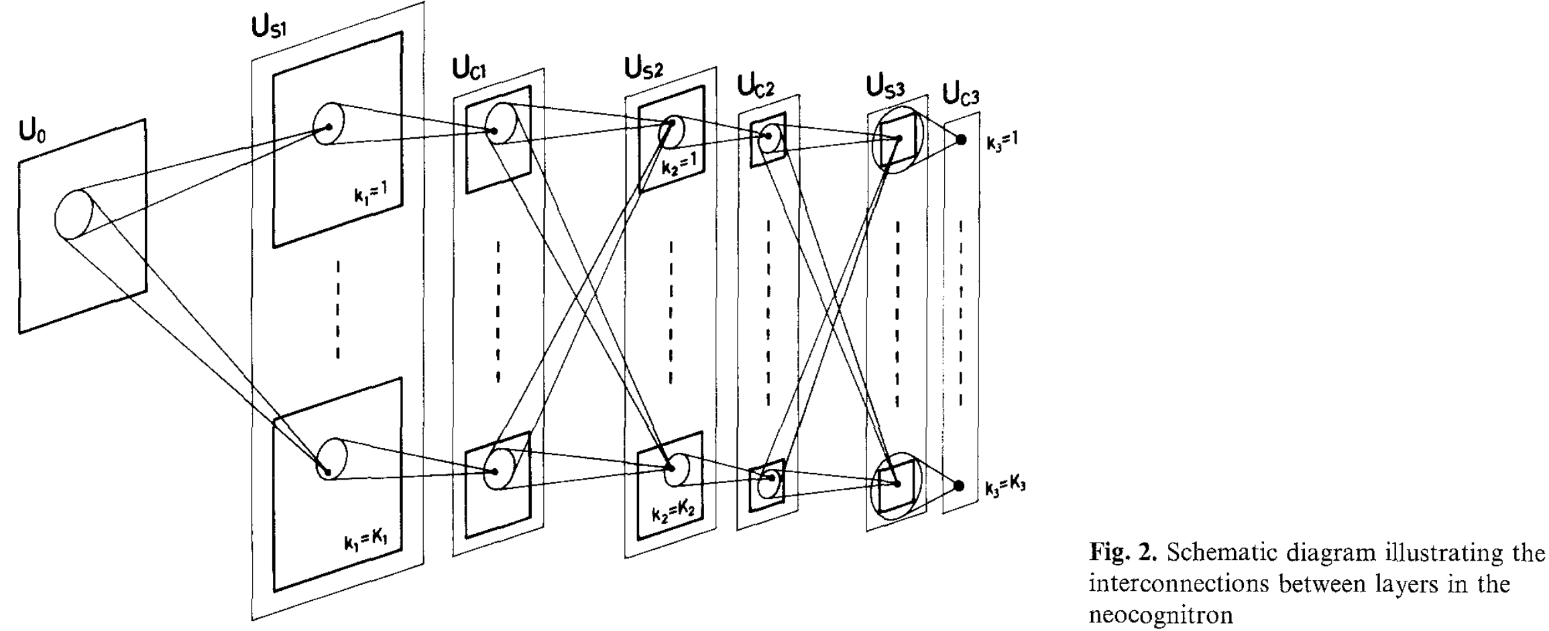
The First Convolutional Neural Networks: Neocognitron (1980)
Fukushima, Kunihiko. "Neocognitron: A self-organizing neural network model for a mechanism of pattern recognition unaffected by shift in position." Biological cybernetics 36.4 (1980): 193-202.

Slide 36
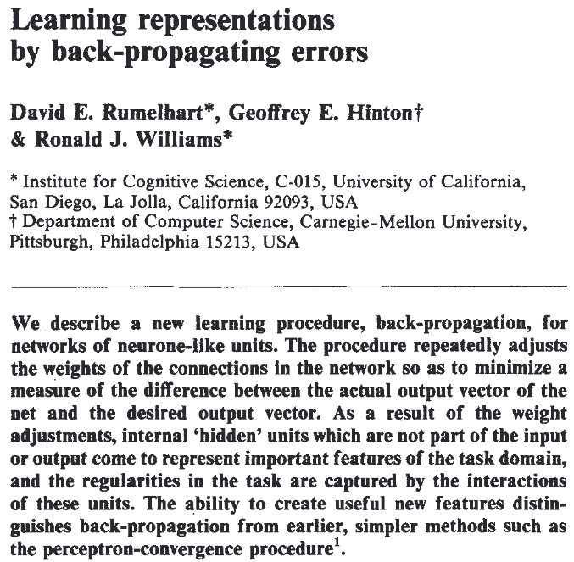
The Back-Propagation Algorithm (1986)
Forward pass
Output
Gold Ans
0.5
1.0
Backward pass
Rumelhart, David E., Geoffrey E. Hinton, and Ronald J. Williams. "Learning representations by back-propagating errors." nature 323.6088 (1986): 533-536.

Slide 37
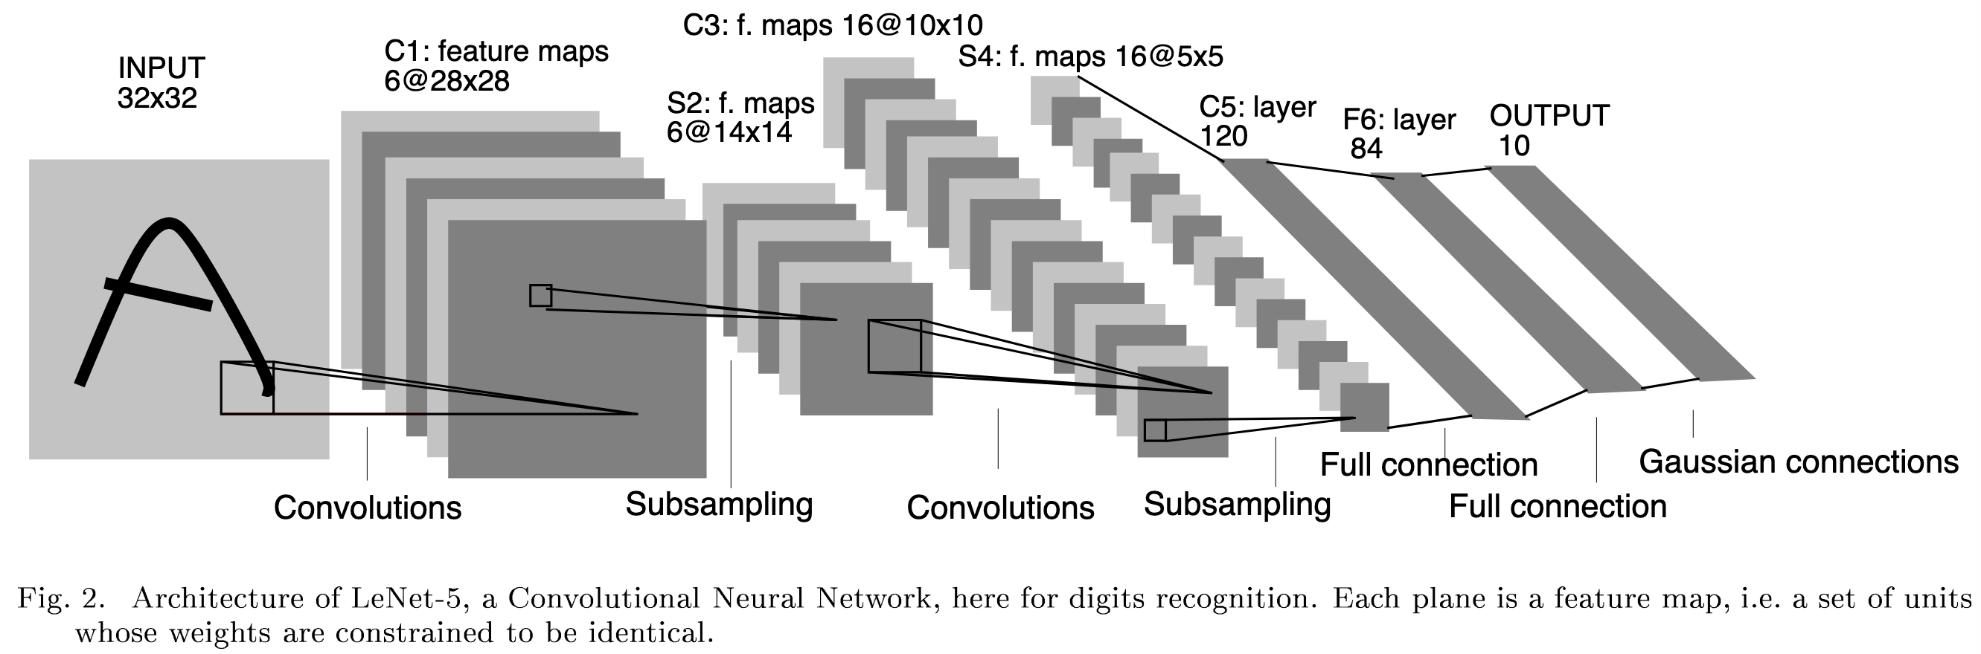
LeNet-5: Early Convolutional Neural Networks
LeCun, Y., Bottou, L., Bengio, Y., & Haffner, P. (1998). Gradient-based learning applied to document recognition. Proceedings of the IEEE, 86(11), 2278-2324.

Slide 38


Examples of Convolutions
Padding = 0, stride = 1
Padding = 0, stride = 2
Figure source: https://hannibunny.github.io/mlbook/neuralnetworks/convolutionDemos.html

Slide 39
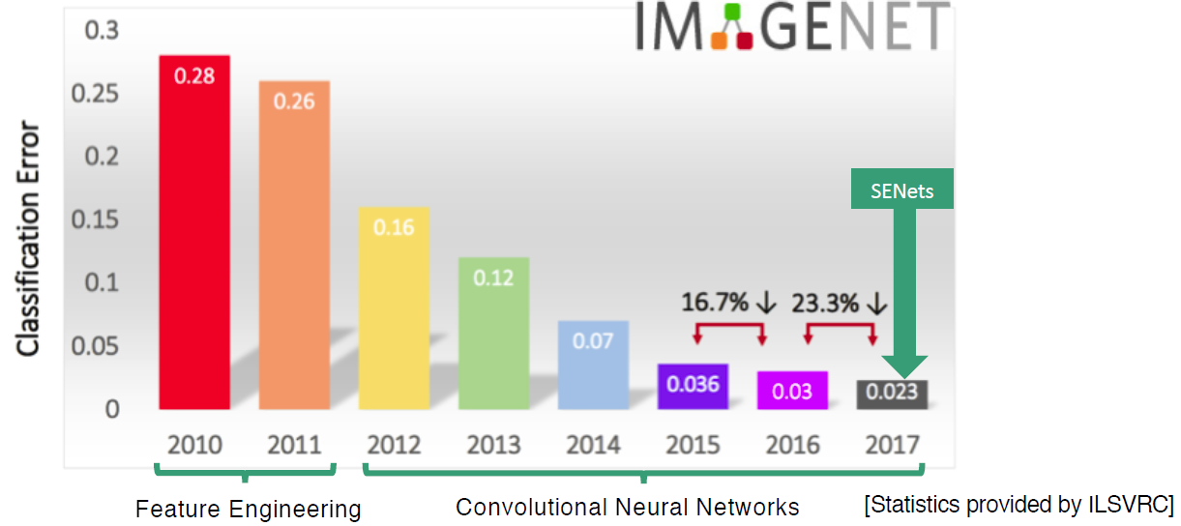
ImageNet Competition
Complete name: ImageNet Large Scale Visual Recognition Challenge (ILSVRC)
AlexNet
Figure source: https://www.kaggle.com/discussions/getting-started/149448

Slide 40
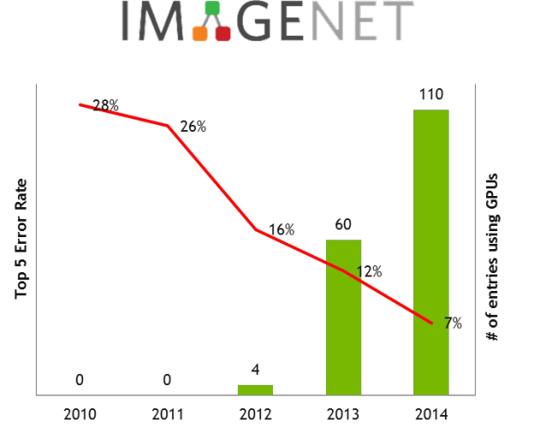
Growing Trend of GPU Usage during the ImageNet Competition
Figure source: https://developer.nvidia.com/blog/nvidia-ibm-cloud-support-imagenet-large-scale-visual-recognition-challenge/

Slide 41
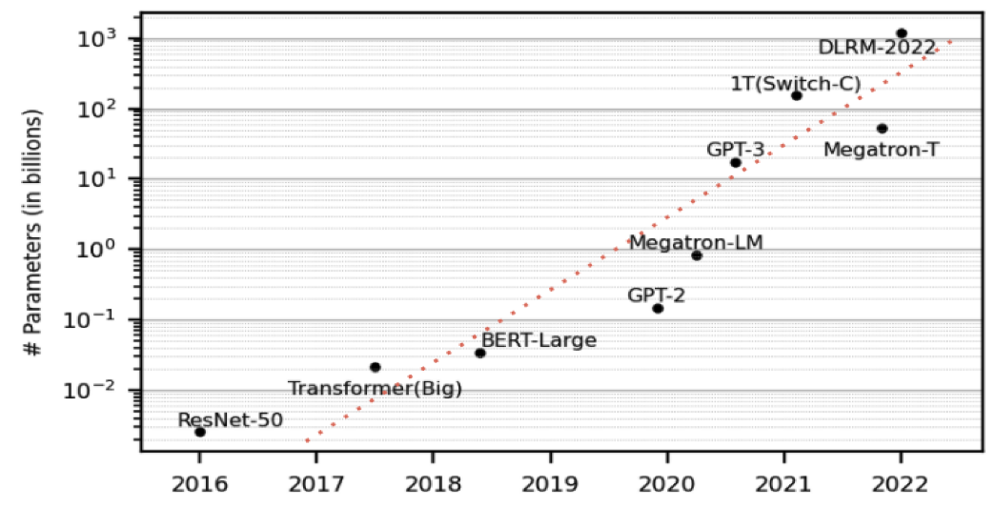
Growing Sizes of Deep Learning Models
Wu, Z., Dai, L. Y., Novick, A., Glick, M., Zhu, Z., Rumley, S., ... & Bergman, K. (2023). Peta-scale embedded photonics architecture for distributed deep learning applications. Journal of Lightwave Technology, 41(12), 3737-3749.

Slide 42

The Revolution of ChatGPT
ChatGPT came out in November, 2022.
Figure source: https://poole.ncsu.edu/thought-leadership/article/lets-chat-about-chatgpt/
https://openai.com/index/chatgpt/

Slide 43
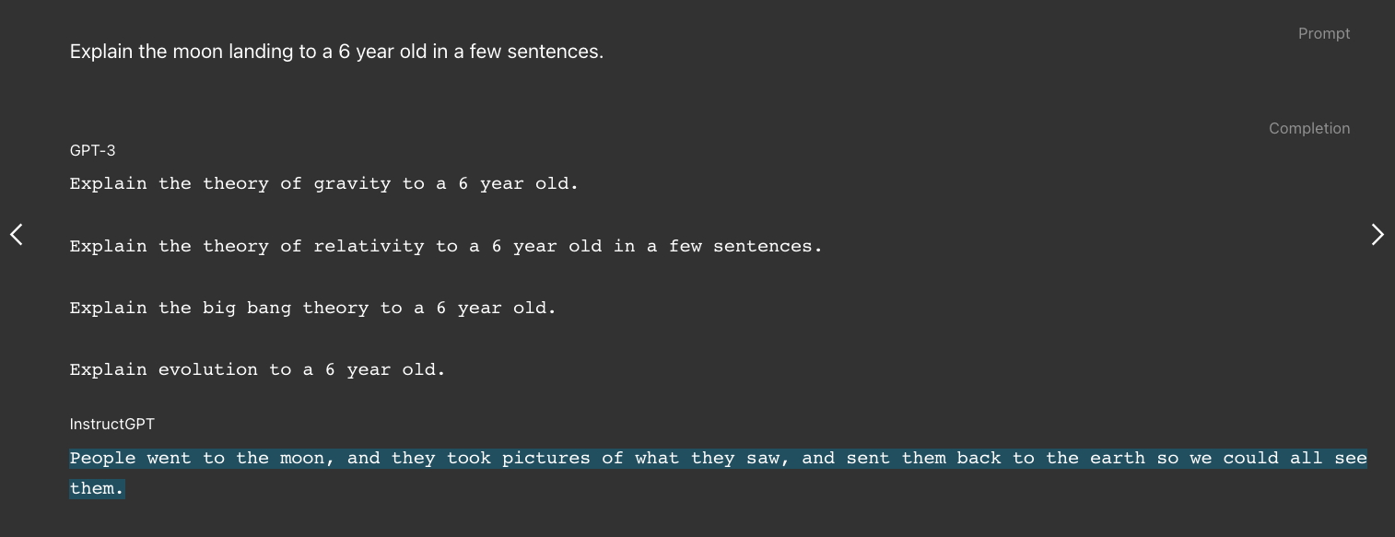
InstructGPT: the precursor of ChatGPT
Model size: 175B (same as GPT-3)
Figure source: https://openai.com/index/instruction-following/
Ouyang, Long, et al. “Training language models to follow instructions with human feedback.” NeurIPS 2022.

Slide 44
模型訓練師新手村

Slide 45

所有的機器學習都是在做最佳化
🤖
模型預測 (Predictions)
目標函數
用來衡量差異
正確答案 (Ground-truths)
最小化Predictions和Ground-truths之間的差異即為機器學習的目標

Slide 46
目標函數的別名
目標函數 (Objective Function)
損失函數 (Loss Function)
誤差值 (Loss)
可能採用「交叉熵」 (Cross entropy)

Slide 47

如何訓練模型：資料集
Training Set
(訓練資料集)
Test Set
(測試資料集)
Training Set
(訓練資料集)
Validation Set
(驗證資料集)

Slide 48
如何訓練模型：演算法
模型預測 (Predictions)
正確答案 (Ground-truths)
透過 Gradient Descent (梯度下降) 尋找最佳解
透過 Back-Propagation 更新權重值 (w跟b)

Slide 49
TensorFlow Playground
https://playground.tensorflow.org

Slide 50
我們這學期要學什麼？

Slide 51

In this course, we will learn:
[Deep Learning Fundamentals]
PyTorch
Gradient Descent
Neural Networks and Back-propagation
Building a Deep Learning Framework from Scratch

Slide 52
In this course, we will learn:
[Deep Learning Applications]
Computer Vision (CNNs)
Natural Language Processing (RNNs)
Modern Architectures (Transformers, Vision Transformers)
Self-supervised Learning
Reinforcement Learning

Slide 53
In this course, we will learn:
[Advanced Topics in Deep Learning]
Model Compression
Big Models and how to train them efficiently
Explainable AI

Slide 54
Scoring of this course
Assignments 7.5% x 4 times (30% in total)
Quizzes: 1% x 10 times
Mid-term exam 30%
Final project 30%

Slide 55
About the Assignments
作業一定都會有範例程式碼 (Sample Code)

Slide 56
Final Project 是什麼？
Final Project 是一種完整的訓練
你將自行從頭到尾做完一個題目，包含：
資料前處理 (Data Pre-processing)
模型訓練 (Model Training)
模型評估 (Evaluations) -->了解問題並改進模型
每組人數待修課同學總數訂定，原則上1-3人/組

Slide 57
Syllabus
Week | Topic | Note
1 | 深度學習介紹以及本課程綱要 (Introduction to Deep Learning / Syllabus)
2 | PyTorch教學 / 梯度下降 (I) | (最佳化)
3 | 梯度下降 (II)
4 | 神經網路與反向傳播法 | HW1
5 | 手把手實作深度學習框架細節探索
6 | 卷積神經網路 (with LAB)
7 | 循環神經網路 (with LAB) | HW2
8 | 自注意力模型 (with LAB)
9 | 期中考
10 | 自監督式模型方法 | HW3
11 | 強化學習 (Reinforcement Learning)
12 | 模型壓縮 (Model Compression)
13 | 大模型時代如何有效率訓練模型？ | HW4
14 | 可解釋性人工智慧
15 | 小組實作成果報告 (1)
16 | 小組實作成果報告 (2)

Slide 58
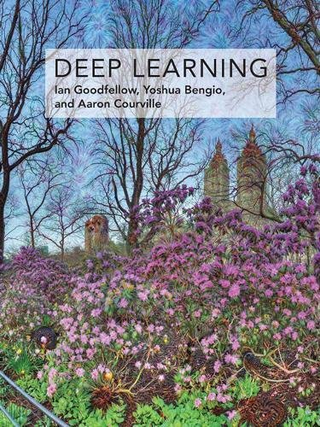
Textbook
Ian Goodfellow, Yoshua Bengio, & Aaron Courville (2016). Deep Learning. MIT Press.
Free Online book: https://www.deeplearningbook.org/

Slide 59
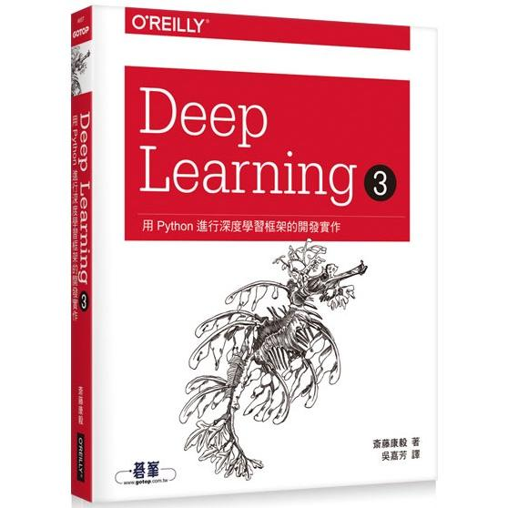
Reference book
Deep Learning 3｜用Python進行深度學習框架的開發實作，歐萊禮 (ISBN: 9789865027346)
GitHub of this book:
https://github.com/oreilly-japan/deep-learning-from-scratch-3

Slide 60
More resources for XOR
Community blog post
https://dev.to/jbahire/demystifying-the-xor-problem-1blk
https://chih-sheng-huang821.medium.com/機器學習-神經網路-多層感知機-multilayer-perceptron-mlp-運作方式-f0e108e8b9af
Stanford course:
https://youtu.be/s7nRWh_3BtA?si=ZEGRN5pmPchM0NxM
Also, in Deep Learning book (Chapter 6.1)

Slide 61
Contact Information
Instructor: 林英嘉
✉️ yjlin@cgu.edu.tw
🕘 Office Hour: 歡迎來信預約，一定沒問題
TA: 林君襄
✉️ becky890926@gmail.com
寄信前請在主旨加註記 [深度學習]

Slide 62
Thank you!
Instructor: 林英嘉
✉️ yjlin@cgu.edu.tw

